Slide 1
Housing Market Pricing Analysis
Scott Breitbach, Pushkar Chougule, and Rachel Nelson
Milestone 4 – Project Presentation & Status
Bellevue University

Slide 2
Housing Prices
Is this house priced right?
Due to market conditions, it’s hard to know what is considered a “good deal”. By predicting house prices based on factors, we can compare our predicted price to the asking price of a home for sale to help us place a proper bid on a house or sell an existing home.

Slide 3
Overview of Kaggle data set
Available data consists of training (train.csv) and testing (test.csv) data sets
Test data set does not contain target variable and will not be used for modeling
Each data set contains 80 columns and almost 1500 rows (81 with target variable)
Target prediction variable is `SalePrice`
The property's sale price in $USD
About our data set:
Some numeric
Some ordered (i.e. quality low to high)
29 Numeric variables
Some continuous (e.g. square feet, price)
Some discrete (e.g. number of rooms)
5 DateTime variables
47 Categorical variables

Slide 4
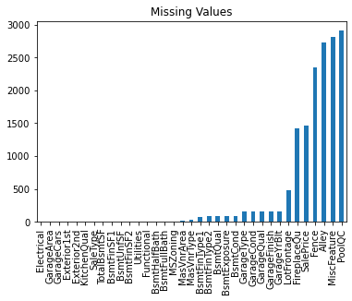
Data Preparation: Imputing Null Values
Most Null values represented the absence of a category (i.e. no garage)
These were changed to 'None' so they could be included
Many Null values for numerical columns were also related to absence of a category (e.g. 'GarageArea')
These were change to a value of '0'
This took care of the vast of Null values
Any remaining null values were imputed with the mean or mode
Mean for numerical variables
Mode for categorical variables

Slide 5
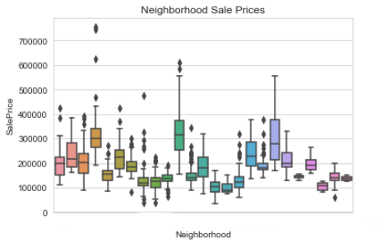
Data Preparation: Plots
We reviewed boxplots of categorical data to see which ones we could remove based on categorical distributions compared to sales price.

Slide 6
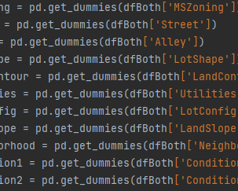
Data Preparation: Dummy Variables
We created dummy variables for categorical items. This changes data from categorical to Boolean values

Slide 7
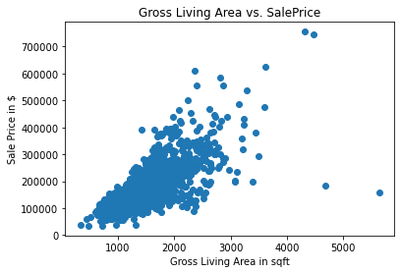
Data Preparation: Feature Selection
We used various techniques to help with feature selection
Correlation: Focused on features with high positive/negative correlation (using Pearsons correlation coefficient)

Slide 8
Modeling
Different models tried
Comparing accuracy

Slide 9
Discussion / Analysis
Issues / Challenges
Future plans

